Slide 1


<FED UP/>
Nobody Cares About Your UI
Misconceptions in UI/UX Design
Michael Irigoyen
Software Engineer III, Team Trogdor
Accusoft Corporation
mirigoyen@accusoft.com

Slide 2
HELLO!
I am Michael Irigoyen.
UI/UX design for 15+ years
PHP for 13+ years
JS/ES for 10+ years
Node.js for 1+ years

Slide 3
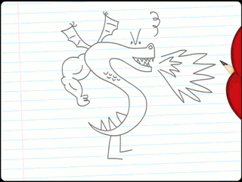
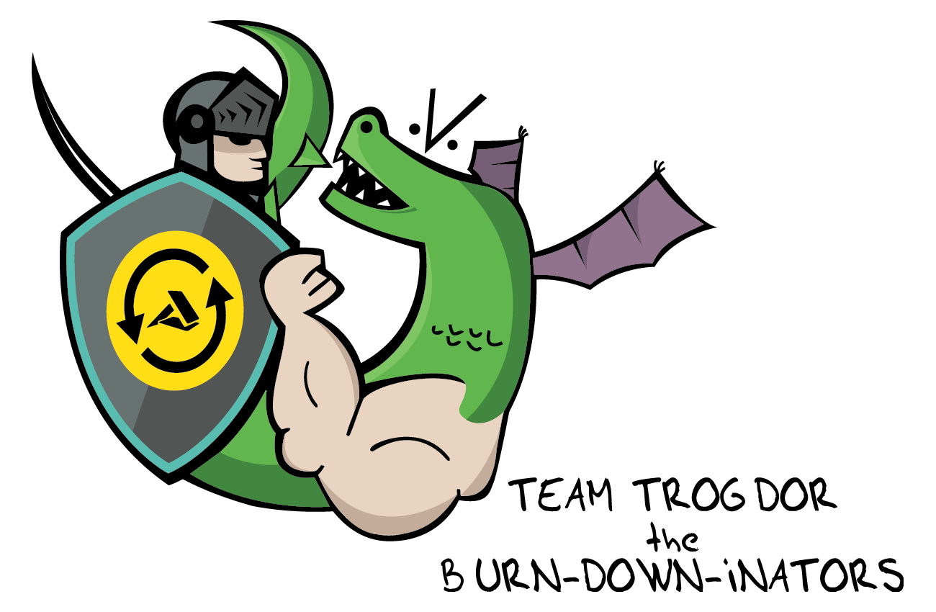
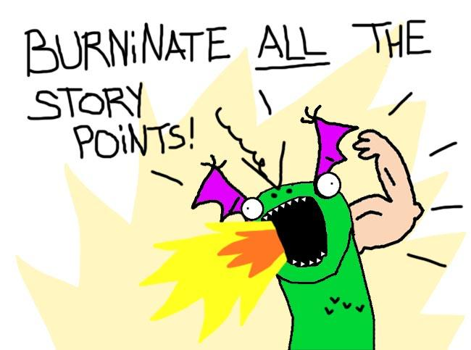
That looks really good coming out of the back of his neck there...

Slide 4
A user interface is like a joke. If you have to explain it, it’s not that good.
-Martin LeBlanc

Slide 5
People Care About Your UI
Misconception

Slide 6

People Care About Your UI
Misconception
Themselves
Your average user is not interested in your UI
They care about what they’re trying to accomplish
Your design should…
Solve problems
Be intuitive
Perform well
Incorporate the simplest solution
If an average user has an opinion about your UI, you may want to rethink your design
“Simple is hard. Easy is harder. Invisible is hardest.”
- Jean-Louis Gassée
HP, Apple, Nokia

Slide 7
UI and UX
Are the Same Thing
Misconception

Slide 8
UI and UX Are the Same Thing
Misconception
Not
User Experience Design
Process of enhancing customer experience
Improve usability
Create ease of access
Promote satisfaction
Responsibilities:
Competitor analysis
Usability studies
Wireframing
Minimal code prototyping
User Interface Design
Process of developing the interface
Use of attractive graphics, colors, and aesthetics
Responsive experience for users
Responsibilities:
Technology analysis
Target audience analysis
Branding/graphic development
Front-end code development

Slide 9
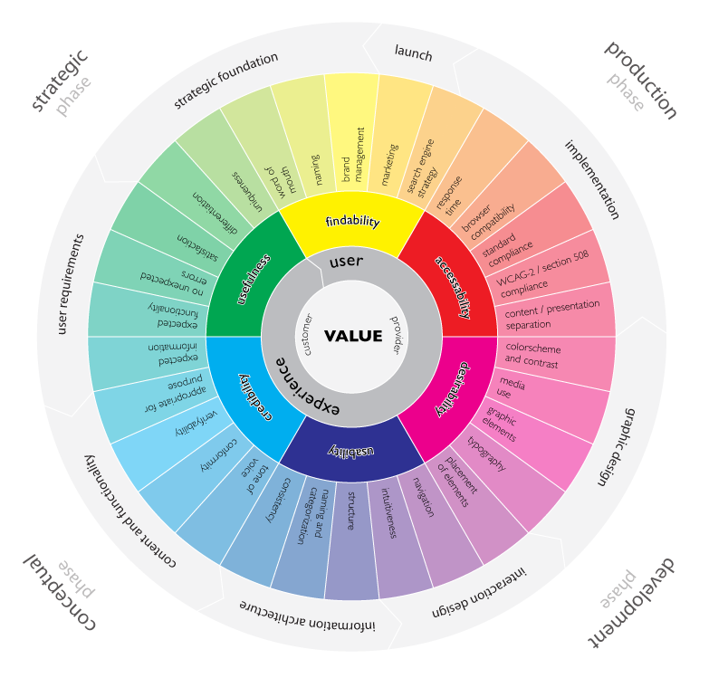
User Experience Wheel
By Magnus Revang

Slide 10
Design is About Making a Website Look Good
Misconception

Slide 11
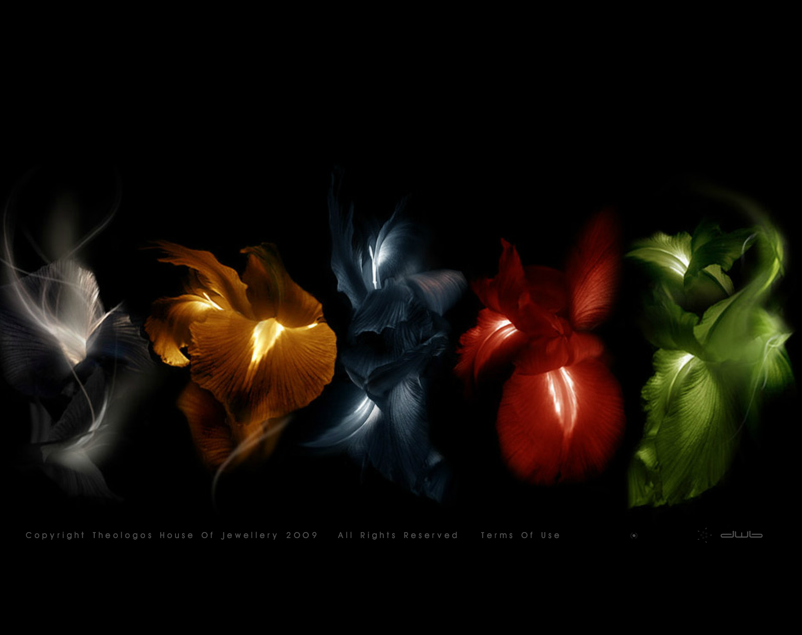
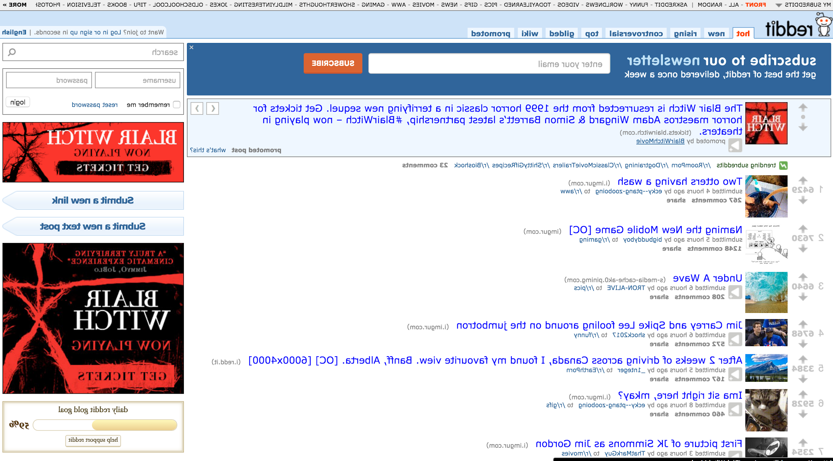
Which has the better design?
Theologos House of Jewellery
Reddit

Slide 12

Design is About Making a Website Look Good
Misconception
Functional
Design is about form and function
Principle older than the web
Comes from modernist architecture design
Shape of building/object should be primarily based upon its intended function/purpose
Goal of design is to efficiently solve problems
Compared to typical art, good design is not only visually appealing but it is made for use
Colors and fonts are a footnote
“Design is not just what it looks like and feels like. Design is how it works.”
- Steve Jobs
Apple

Slide 13
Design Has To Be Original
Misconception

Slide 14


Design Has To Be Original
Misconception
Evolutionary
Don’t reinvent the wheel
Don’t make your users think
Don’t plagiarize
Expand on the ideas and research others have done
Utilize frameworks, such as Bootstrap or Foundation
Innovate when necessary
“Immature poets imitate; mature poets steal; bad poets deface what they take, and good poets make it into something better, or at least something different.”
- Bill Gates
“Immature poets imitate; mature poets steal; bad poets deface what they take, and good poets make it into something better, or at least something different.”
- T.S. Eliot

Slide 15
If It Works For ______,
It’ll Work For You
Misconception
Google
Amazon
Apple
Microsoft

Slide 16
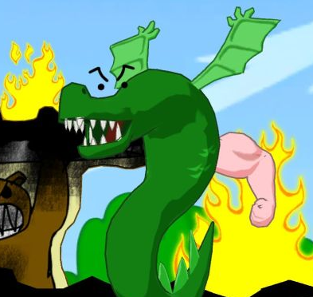
If It Works For ____, It’ll Work For You
Misconception
Identify Why
It is an excuse; lazy design
Does ____ have the same goals as you?
Identify the problem you are trying to solve
Don’t copy functionality blindly
You don’t know the reasons behind the design
You are not responding to your user’s needs
You devalue your own data
Again, make it into something better
Burninating all the peasants works for Trogdor, but would probably put you in jail.

Slide 17
Important Content Needs To Be Above the “Fold”
Misconception

Slide 18
75%
90%
700px
People who begin scrolling before page finishes loading¹
Mobile users start scrolling < 14 seconds²
Majority of a user’s time is spent below³
^{1,3} https://storify.com/xiwcx/there-is-no-fold-1
² https://twitter.com/lukew/status/629694224535957504/

Slide 19
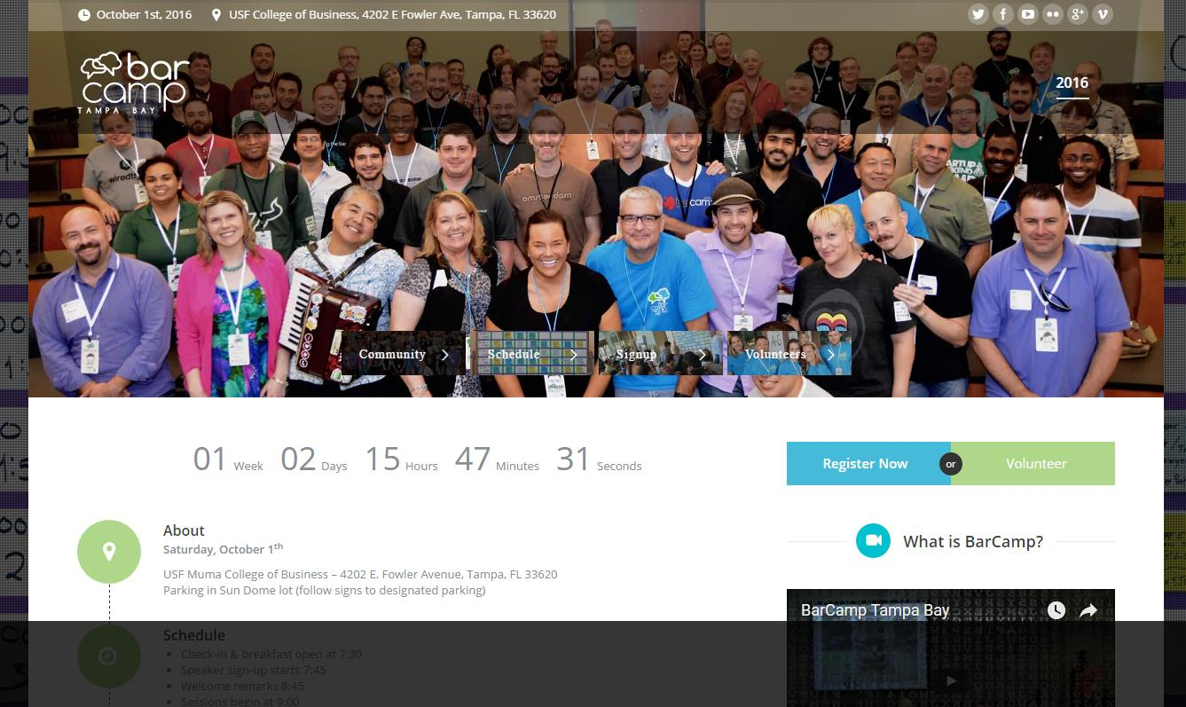
Important Content Needs To Be Above the “Fold”
Misconception
Easy to Find
Scrolling is instinctual, clicking is a decision
Don’t jam as much as possible above 700px
Negative space is important!
Keep navigation simple and minimal
Duplicate navigation in your footer… People scroll!
Consider utilizing “hero” headers
Less content above the fold sparks curiosity and may promote more exploration

Slide 20
Tables Are Evil
Misconception

Slide 21

Trogdor Statistics
 | Burninated | Stomped
Countrysides | 1 | 0
Peasants | 25 | 15
Thatched-Roof Cottages | 10 | 0

Slide 22
Tables Are Evil
Misconception
For Tabular Data
By now we know to never use <table> for layouts
HTML is a semantic language
Tables limit design responsiveness
Tables limit design accessibility
Browsers must read tables twice to render them
Exception: HTML emails
Never use CSS’s display property to create a table for tabular data
HTML is a semantic language
Pseudo-tables limit data accessibility

Slide 23
Users Make Good Choices
?
Misconception

Slide 24
Users Make Good Choices
Easy
Misconception
Users…
Are impatient
Will click on the first thing that resembles what they want
Believe guessing wrong and hitting back is more efficient
Will leave within 60-90 seconds of not finding what they want
Developers…
Make sure your back button behavior works
Duplicate important navigational links
Make sure key points are hyperlinks
Keep links distinct and concise
Provide a search mechanism

Slide 25
Accessibility is
Not Worth the Time
Misconception

Slide 26
Accessibility is Not Worth the Time
Misconception
Reach a bigger audience¹
~285 million people cannot read all content online
~39 million cannot access any content via sight
~600 million people suffer from hearing problems or deafness
Accessible sites are more semantically correct
Better usability
Better SEO
Accessibility is required by law for government sites and highly recommended for private
Target Corp. sued and settled over web accessibility issues in 2005
¹ https://www.sitepoint.com/how-many-users-need-accessible-websites/

Slide 27


Join Our Team
Accusoft is hiring! Come join our team!
Cool perks:
Great work-life balance
Monthly tech meetups
Social events
Free snacks!
Node.js, .NET, C++, Java, HTML, JS, etc.
Marketing & Sales
http://www.accusoft.com/careers

Slide 28
THANKS!
Any questions?
You can find me at @mririgo & mirigoyen@accusoft.com

